Slide 1
Mantid Release Presentation
Release 2.5

Slide 2
What is this meeting
Release 2.5
Timeline
Present the changes and improvements
Questions
I didn’t catch what you meant – ask immediately
I’d like to add something – at the end of each section
I wish it did this – Talk to the developer at the end

Slide 3
Release Timeline
April 30th
May 3rd
May 10th
Developer Testing
Final Fixes
Beta Testing
Release
Release
Presentation

Slide 4
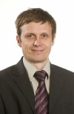


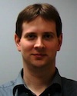
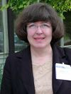

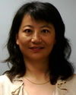
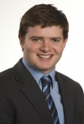

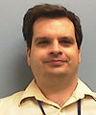
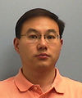
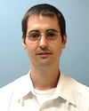

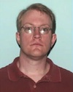


The Team
Anders Markvardsen
Karl Palmen
Dereck Kachere
Alex Buts

Slide 5
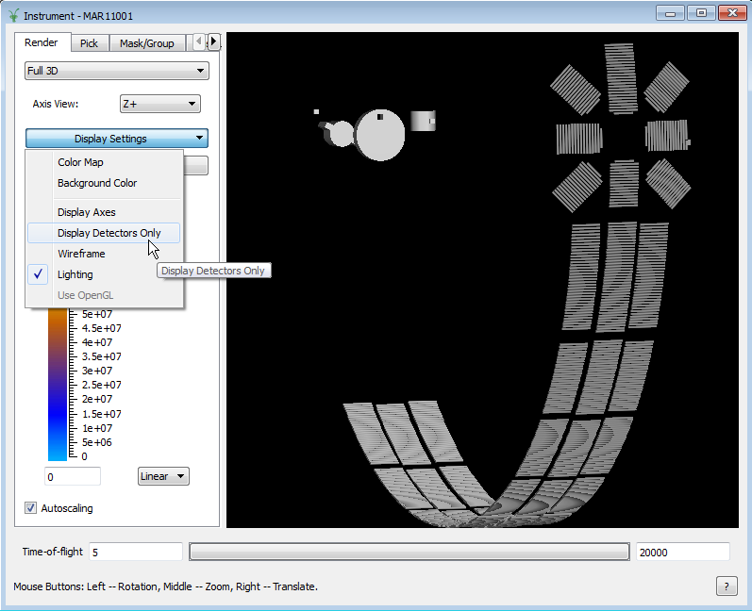
Show/hide non-detector components

Slide 6
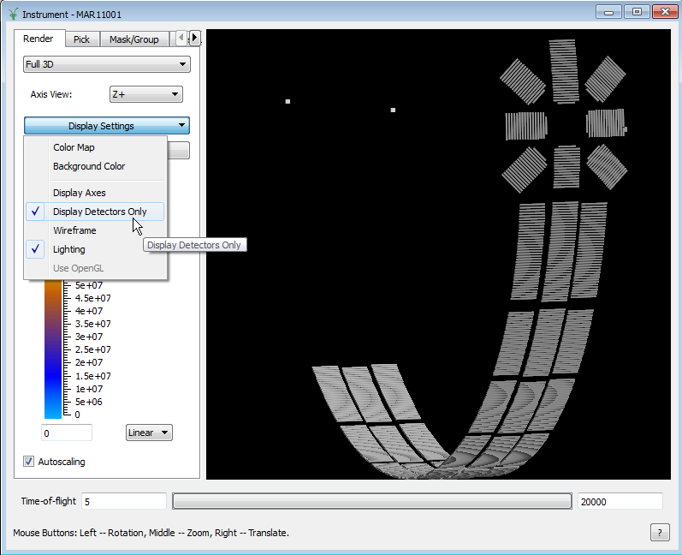
Show/hide non-detector components

Slide 7
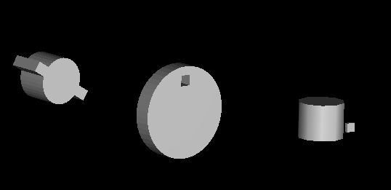
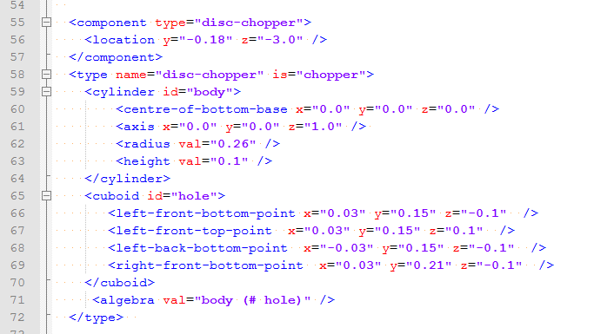
Show/hide non-detector components
Instrument definition file entry is similar to those of detectors or monitors
Just define it as something other than detector or monitor

Slide 8
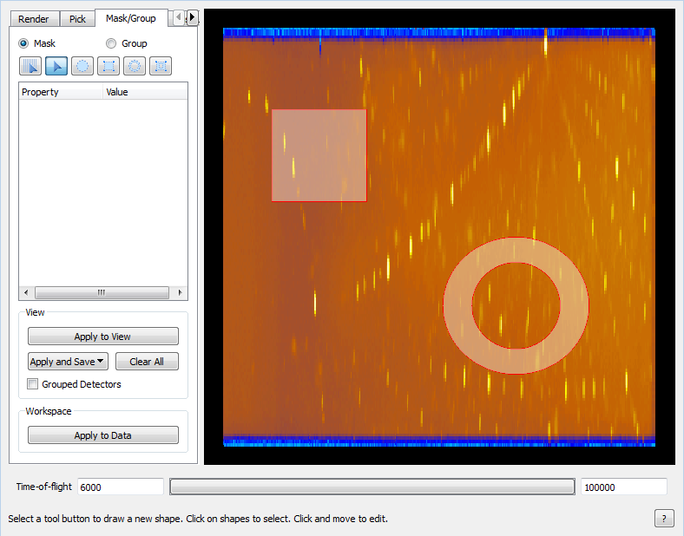
Mask/Group tab
Switch
Masking and grouping on the same tab

Slide 9
Mask/Group tab
Two ways of applying a mask:
to the view
to the data

Slide 10
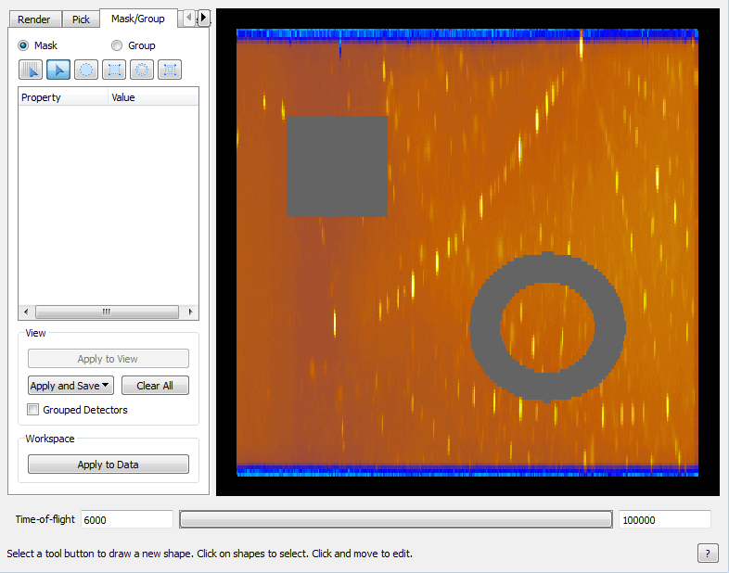
Mask/Group tab
Click
Applying to view:
can be cleared
can be saved to workspace or file
underlying workspace doesn’t change

Slide 11

Mask/Group tab
Click
Applying to data:
cannot be cleared
changes underlying workspace

Slide 12
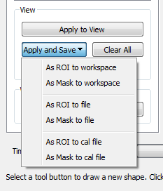
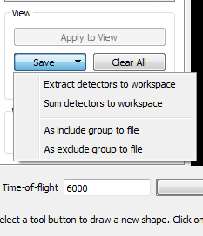
Mask/Group tab
Masking
Grouping

Slide 13
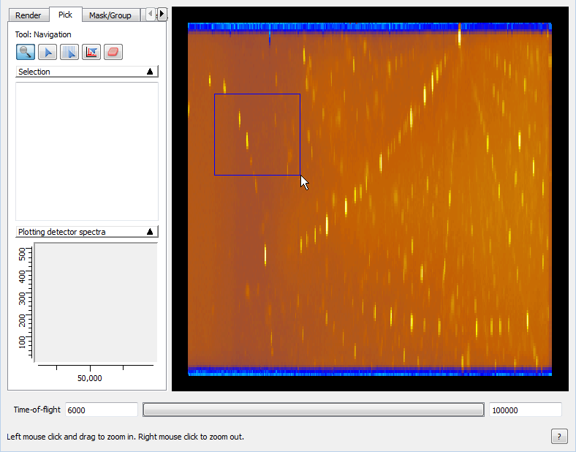
Pick tab
Select
Zoom in and out without leaving the tab

Slide 14
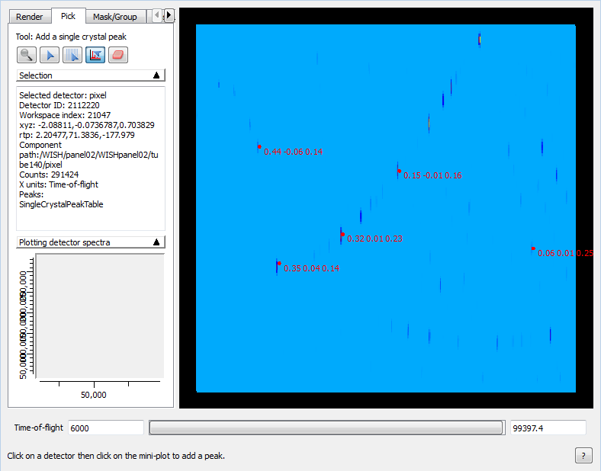
Pick tab
If workspace has UB matrix it is used to calculate hkl values for manually added peaks

Slide 15
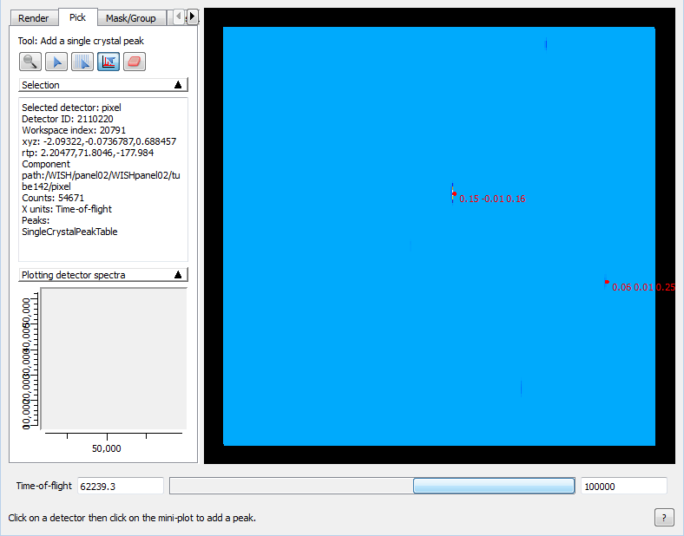
Pick tab
Only those peaks are shown whose centres fall within current integration range

Slide 16
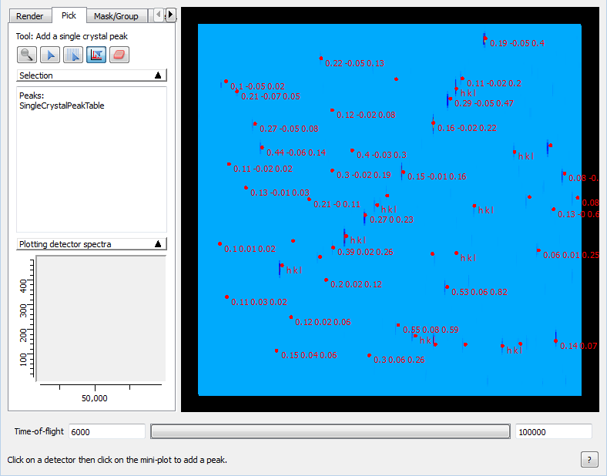
Pick tab
If there are too many peaks to see the labels…

Slide 17
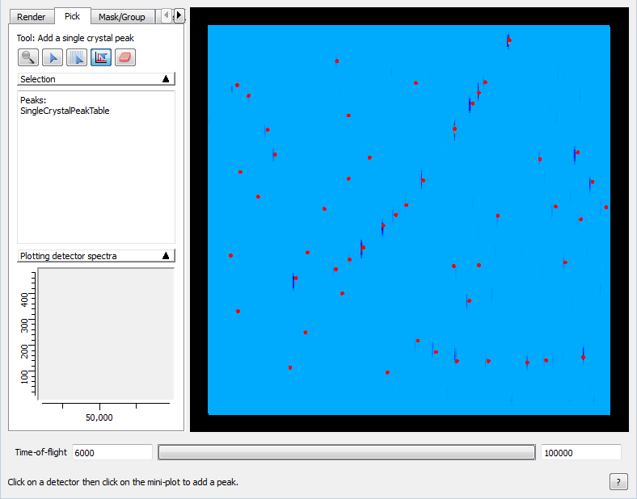
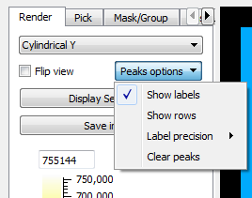
Pick tab
… they can be turned off from the Peaks options (on Render tab)

Slide 18
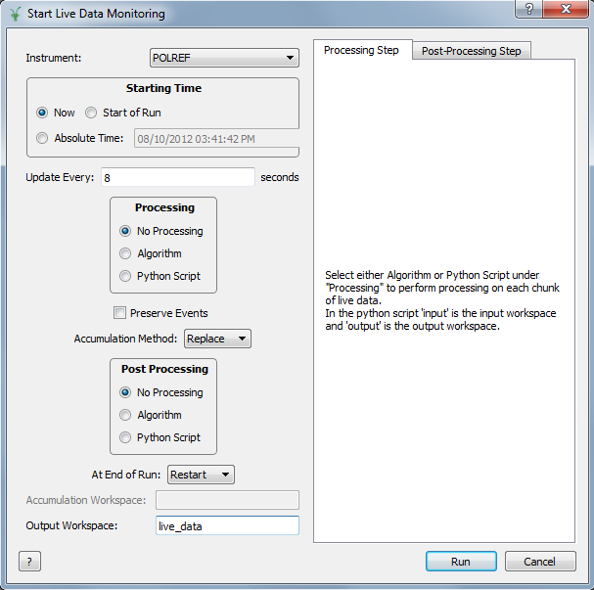
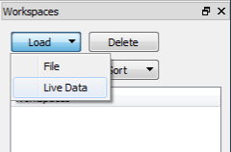
LoadDAE deprecation
The Load button runs StartLiveData algorithm instead of LoadDAE

Slide 19

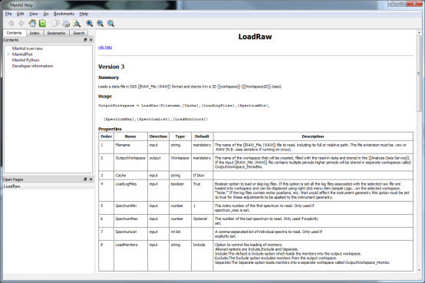
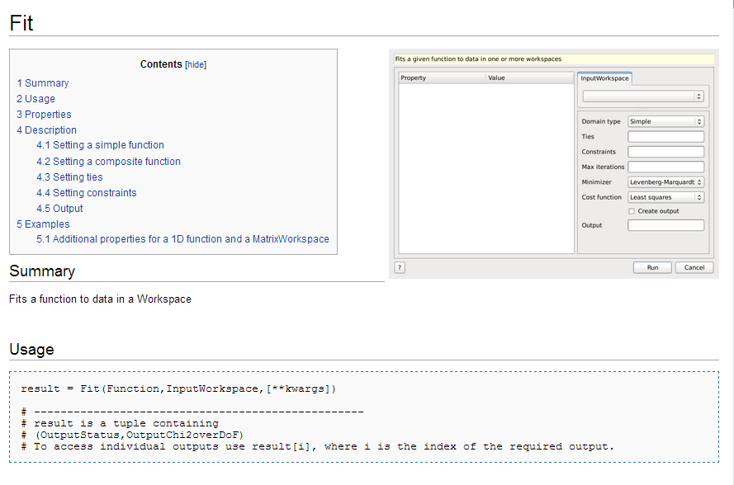
User Interface
Finding Help
Wiki search improved
Offline Help
More detail
Algorithm Pages
Interface Examples

Slide 20
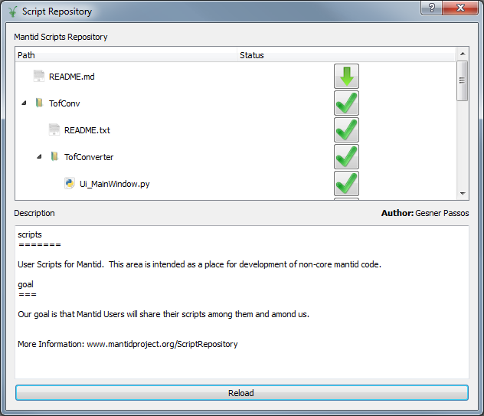
User Interface
Scripting
Code Folding
Script Console log removed
Results now go to the Results log
Script Repository

Slide 21
Script Repository
Tool to download/upload scripts
Wrapper to mantidproject/scripts repository
Aims to help us to move all scripts to Python API version 2 (But we will go to this in a while)
All the versions and the history of your scripts will be backup
Demonstration

Slide 22
Python API retirement
Need to retire v1 “from mantidsimple”
All Scripts need to move to v2 “from mantid.simpleapi”
Timeline
Release 2.5 (May)
Both API work
Script default is v2
Release 2.6 (Aug)
Both APIs work
Deprecation warning for v1
Release 2.7 (Nov)
v2 only works
v1 removed

Slide 23
Python API retirement
How do I update my scripts?
Upload the scripts to the script repository before 30th June.
Try migrate1to2.py
Look here http://download.mantidproject.org/docs/current-release/python/html/changes.html
Contact the Dev Team

Slide 24
Tube Calibration
Example files: C:\MantidInstall\scripts\Calibration\Examples
Wiki link: http://www.mantidproject.org/Tube_Calibration

Slide 25
Example Scripts
For
MERLIN, WISH & MAPS

Slide 26
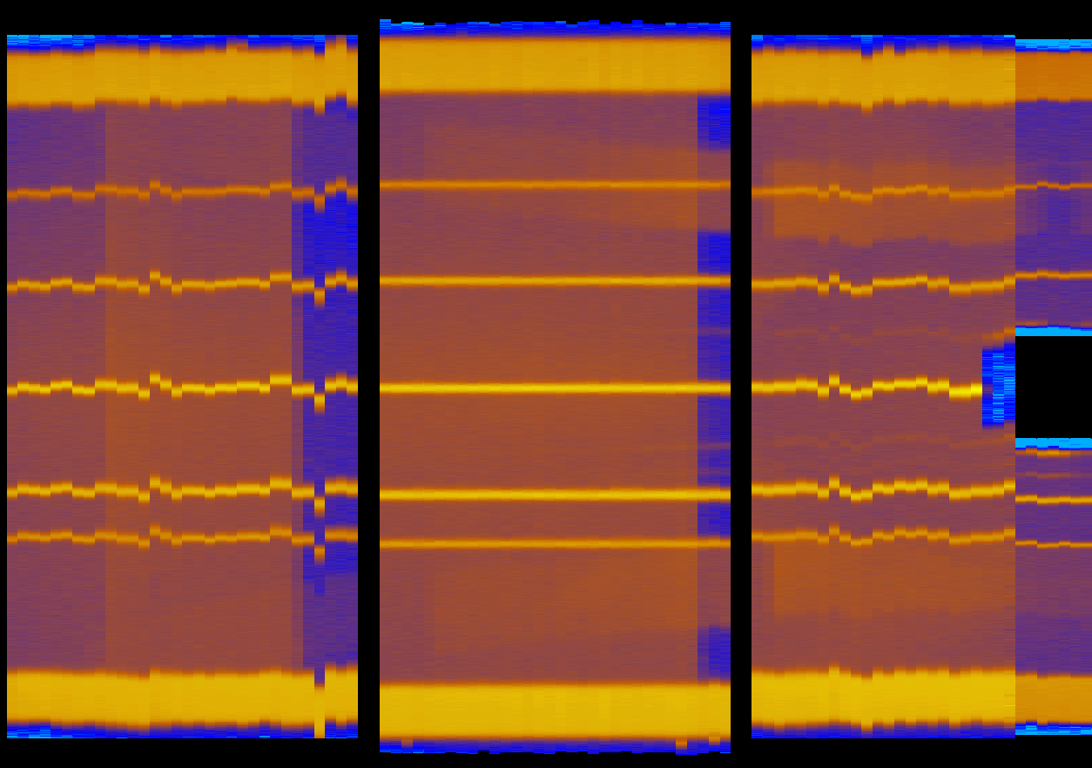
MERLIN Calibration Demonstration

Slide 27
Framework
Neutronic Materials for Absorption corrections
SetSampleMaterial
Xsections & SampleNumberDensity optional for all Absorption correction algorithms
ILL Loading
McStas result file loading
Quality improvements
Dependencies upgrade

Slide 28
Other improvements
Various improvements to LoadSassena
New interfaces
Rocking Curves
Powder Diffraction
Single Crystal Diffraction

Slide 29

Python Fit Functions
Plugin new fit functions written in Python
MantidPlot fitting tools work with them as if they were shipped with Mantid
Simple to quickly prototype a new type of fitting function without C++ code & compiler hassles etc
Two examples shipped in plugins\python\functions

Slide 30
Python – Other Improvements
Progress within Python algorithms
Increased control from Python:
Instrument View: See Instrument View docs on wiki
Workspace axis units: Can have arbitrary labels

Slide 31
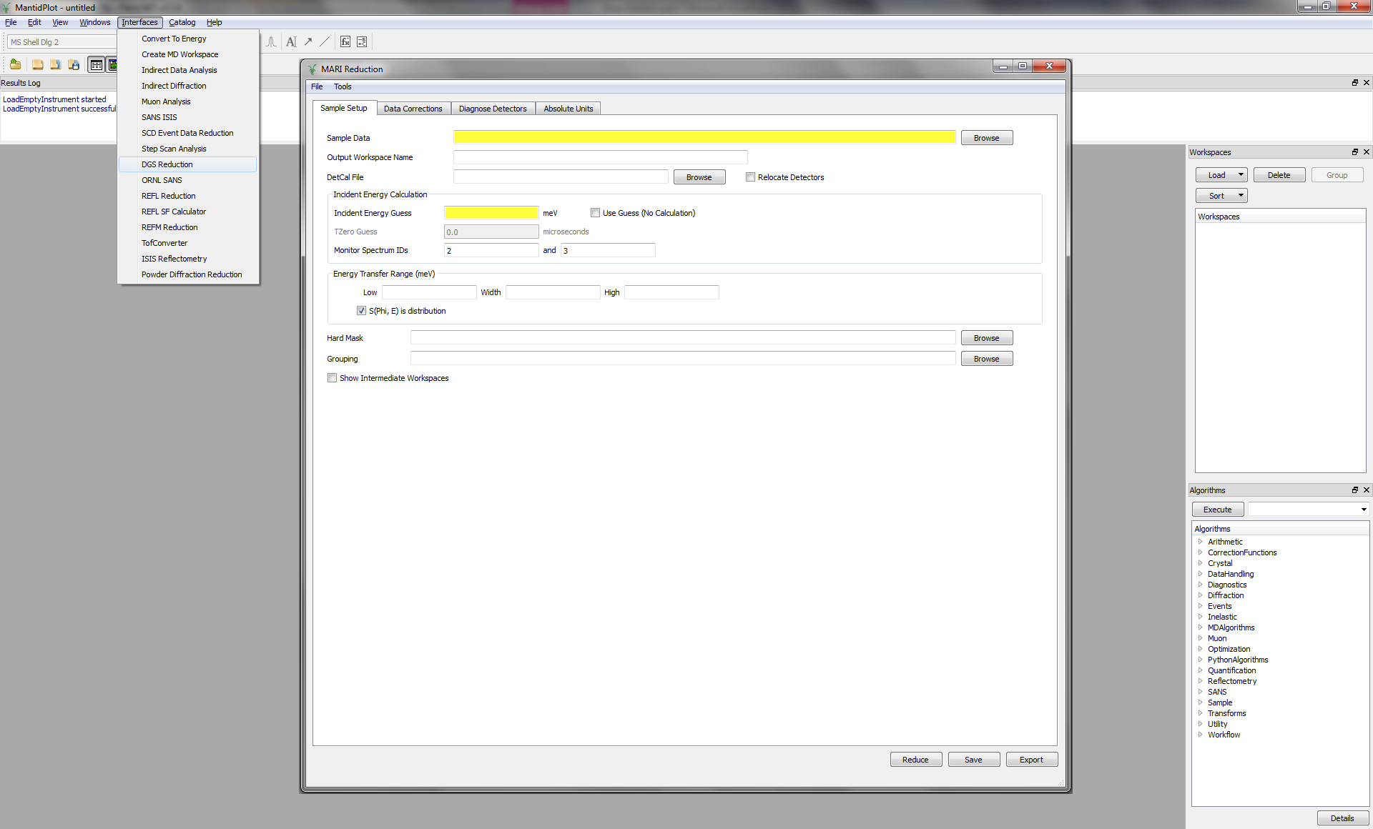
Direct Inelastic – DGSReduction Interface
SNS have created new interface that should work for ISIS data. Long-term view to come to agreement on underlying workflow for both facilities

Slide 32
Single Crystal Diffraction
Mantid 2.5

Slide 33
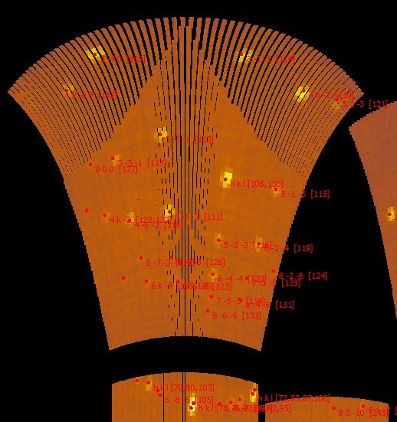
Benchmarking and Improvement
Does the workflow work with real ISIS data?
How can I tune the workflow better on my instrument?
What if the workflow breaks?

Slide 34
Major Algorithm/Workflow Additions
CalculatePeakHKL – InstrumentView
PredictFractionalPeaks
OptimizeCrystalPlacement
ConvertToMD for SX elastic data
SCD GUI (SNS) - ReduceOneSCD_Run.py

Slide 35
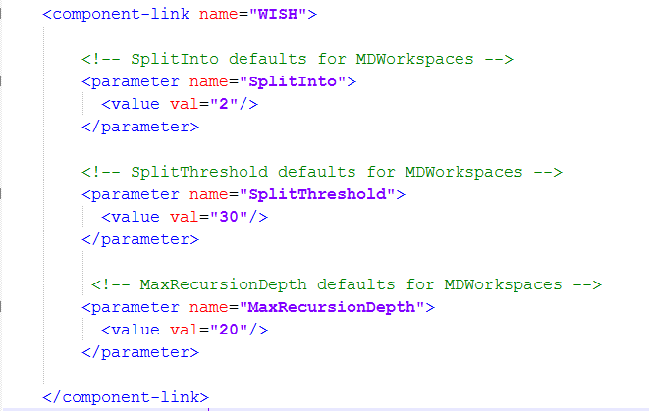
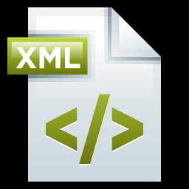
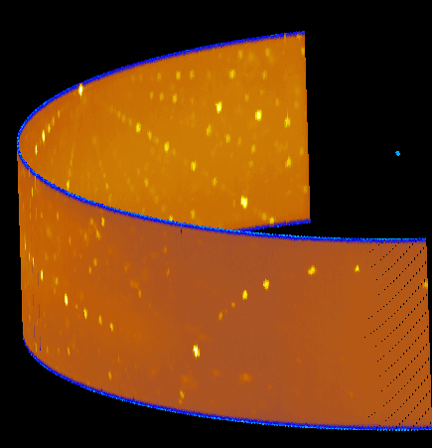
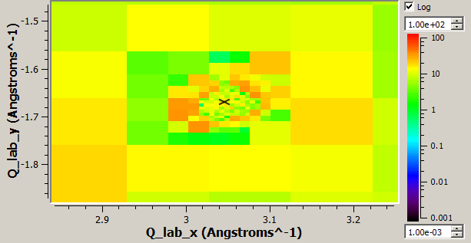
Instrument Specific Splitting
Param File

Slide 36
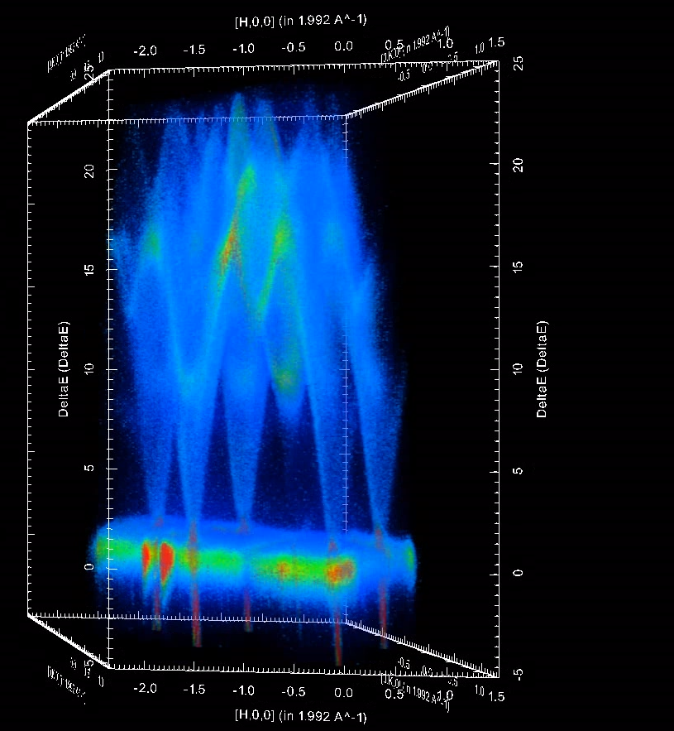
Pending new version of 3D Visualisation tools
Uses brand-new ParaView
Non orthogonal visualisation
Proper axis labelling
Locatability in native coordinate system
Better slicomatic type views

Slide 37
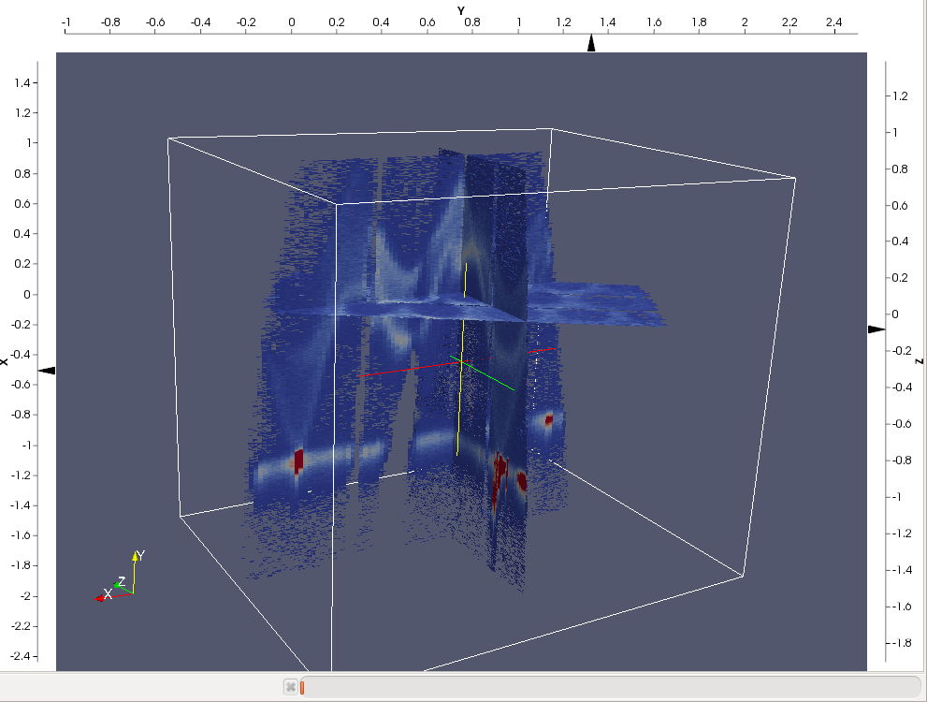
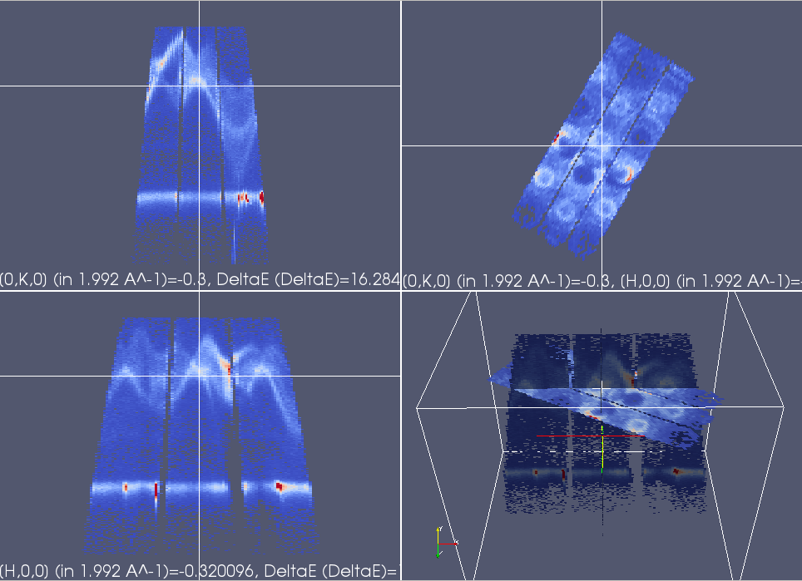

Slide 38
TODO:
Fix Qspace integration region display in the PeaksViewer/SliceViewer
Gaussian fit in Miniplot in InstrumentView
Angles between reflections in plane and out of plane

Slide 39
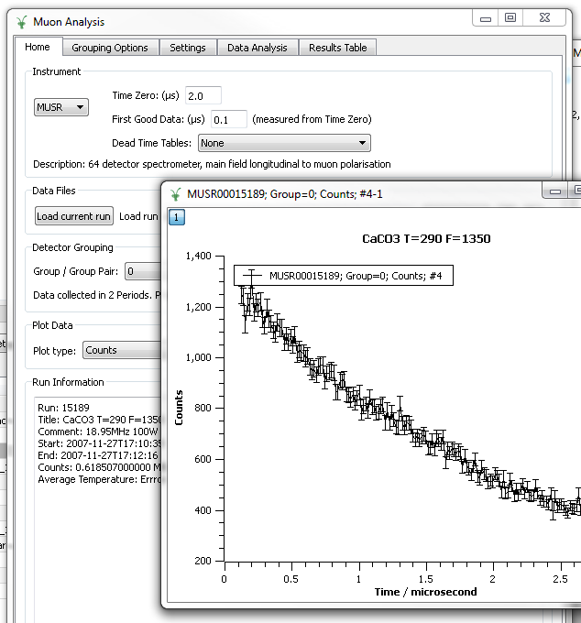
Muon
www.mantidproject.org/Muon

Slide 40
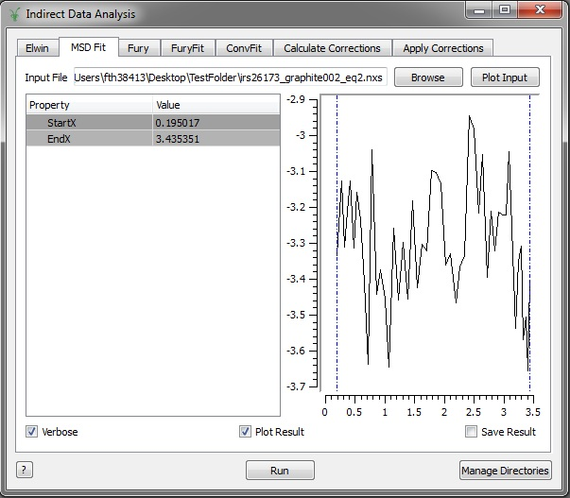
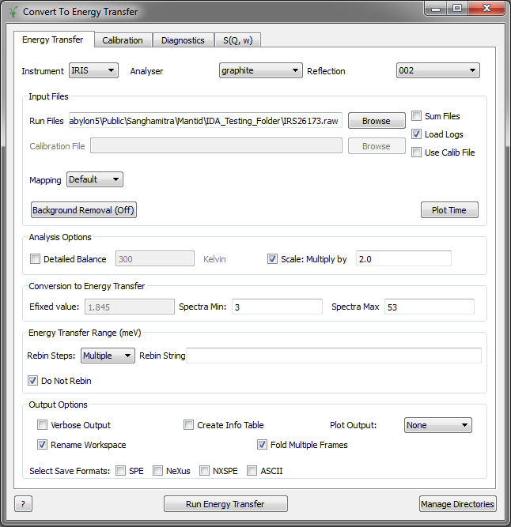
Indirect Inelastic
Changes in the Indirect Data Analysis and Convert to Energy user interfaces.

Slide 41
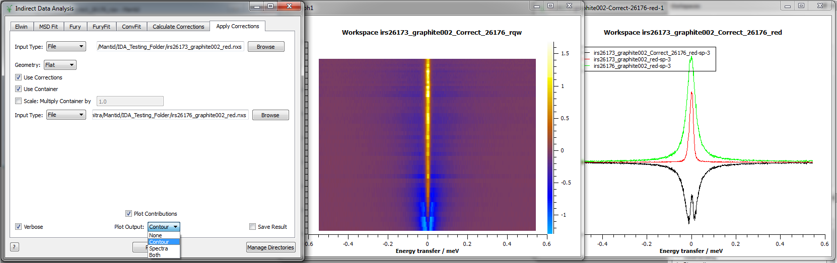
Indirect Data Analysis Interface
Apply Corrections tab: new plotting options – contributions and output.

Slide 42
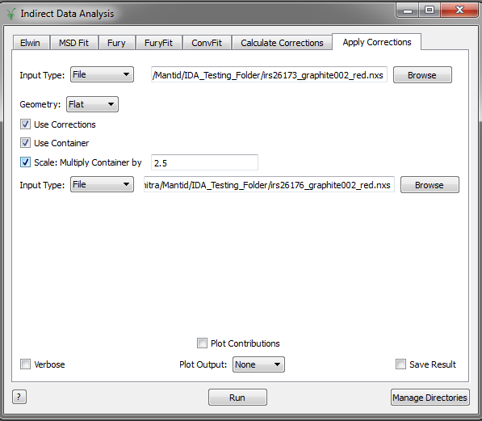
Indirect Data Analysis Interface
Apply Corrections tab: scaling option – can now multiply container data before applying corrections.

Slide 43
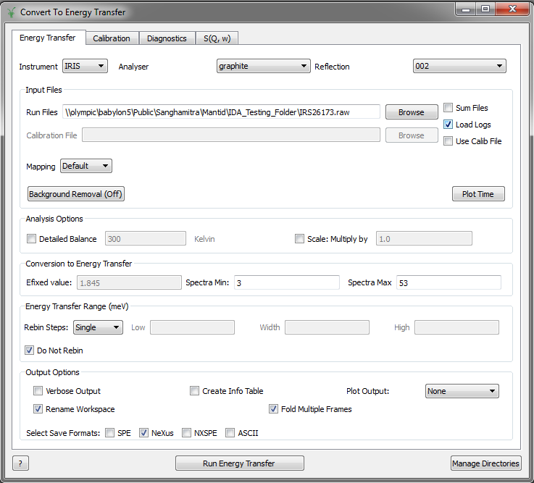
Convert to Energy Interface
Energy Transfer Tab: Option to read sample environment logs of the runs being reduced.

Slide 44
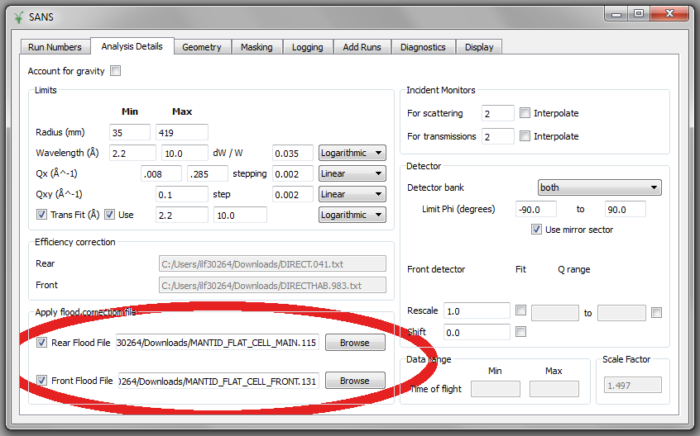
SANS
Improvements on handling Front Detector
Flood Correction
Notes:
In this release we focus on giving the Front Detector the same treatment of the Rear Detector. So, now, we are able to apply Flood Correction for the Front Detector.

Slide 45
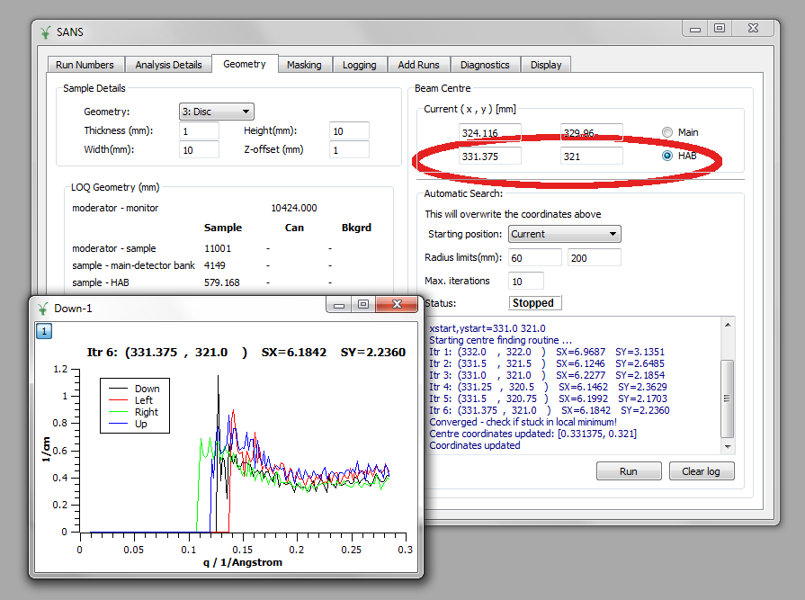
Beam Centre Finder for FRONT/HAB
Notes:
As well as applying searching Centre for the Front Detector.

Slide 46
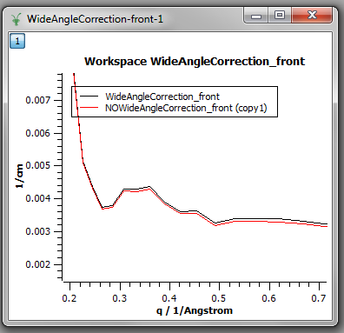
Correction of the Transmission for Wider Angles
Available through UserFile: SAMPLE/PATH/ON
Notes:
We have introduced a new algorithm to compensate the transmission Wide angles. This picture shows the result for a particular dataset, comparing the reduced data when applying or not the correction. This correction is available through the option: SAMPLE/PATH/ON on User Files.

Slide 47
Enhancements
Some Works on SANS2D Event Mode
Adding
Slicing will be available at Next Release.
BatchMode applies the correct suffix to the reduced data (_front, _merged, _rear)
CanSAS – implementation of version 1.1 and introduction of SASdetector field
The Algorithms are available, but their introduction to the Reduction will be available at Next Release.
Notes:
We have started some work on Event Mode data, and is our plan to be able to deal with them directly for the next release. Now, in batch modes we have the correct suffix applied to the detectors, being able to run for the rear, front or even both, and merging the result in a single dataset. In this release, CanSAS version 1.1 is supported as well, but its full integration on the Reduction process is for the next release.

Slide 48
Bug Fixes
Correction of error propagation on Q1D.
The rectangular banks on SANS2D are now enabled at Diagnostics tab.
Process the settings: DET/RESCALE/FIT. Enabling the fit.
Process the settings: DET/CORR, applying the Detector offset.
SaveRKH – Correct the issue when X values are spectrum numbers.
Notes:
Finally, we want to mention some bug fixes. We have spot an error of the Q1D error propagation, which is used for the reduction here and at SNS. The Diagnostics tabs now allow the interaction for SANS2D instruments. There were some issues with the settings DET/RESCALE/FIT and DET/CORR which applies Detector offset. And SaveRKH is now able to record the spectra numbers correctly.

Slide 49

Thank you

